Slide 1
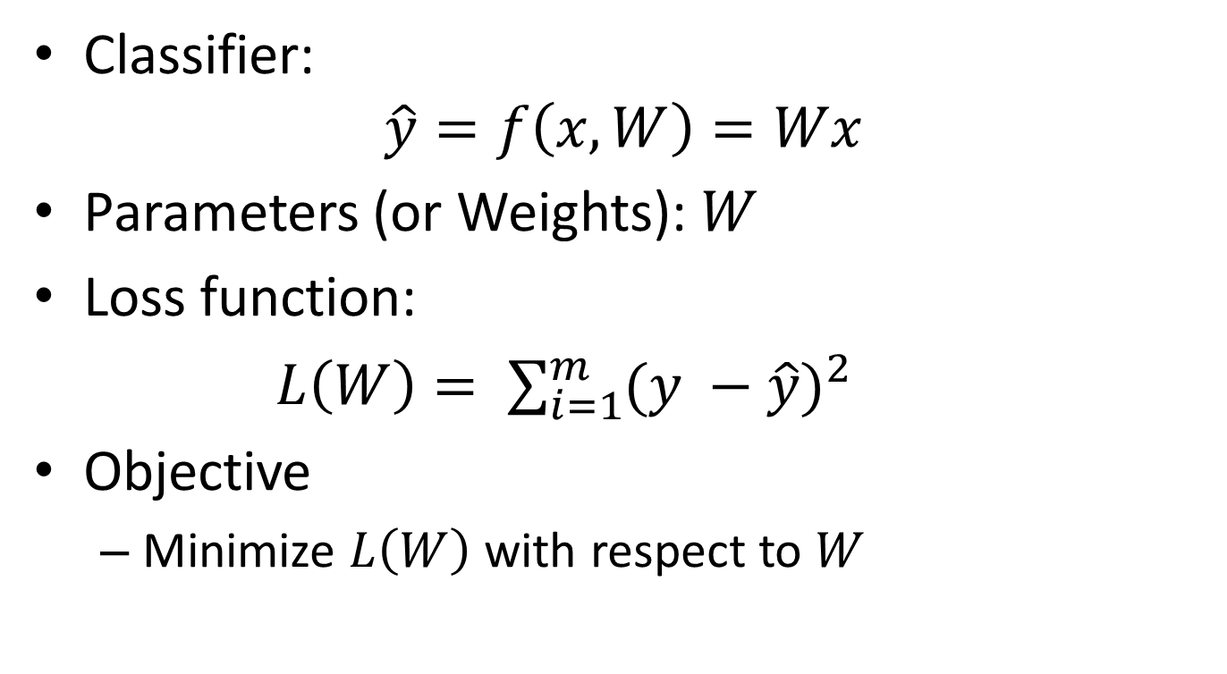
Learning Problem
Classifier:
$$\hat{y}=f\left(x,W\right)=Wx$$
Parameters (or Weights): $W$
Loss function:
$L\left(W\right)= \sum_{i=1}^{m}{{(y −\hat{y})}^{2}}$
Objective
Minimize $L\left(W\right)$ with respect to $W$

Slide 2
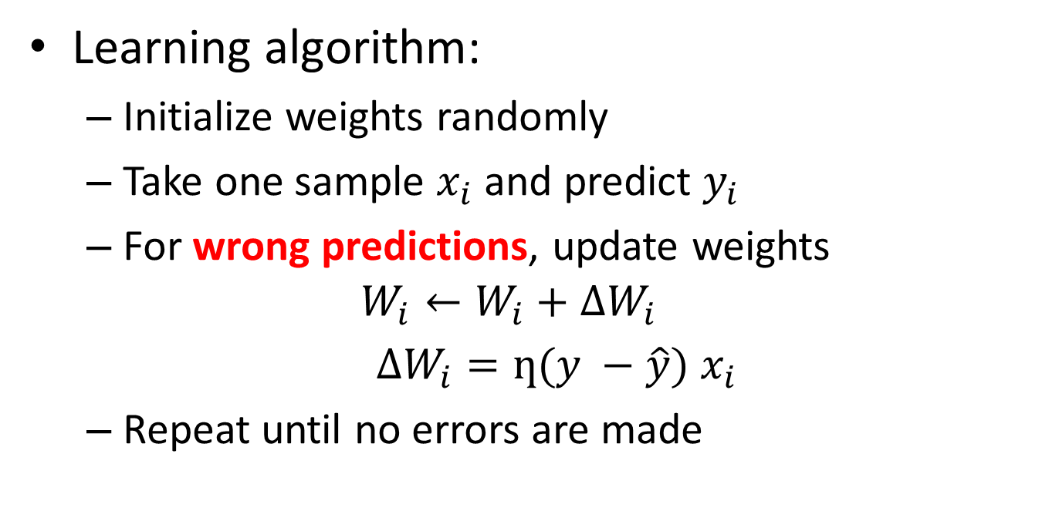
Training a Perceptron
Learning algorithm:
Initialize weights randomly
Take one sample $x_{i}$ and predict $y_{i}$
For wrong predictions, update weights
$$W_{i}←W_{i}+∆W_{i}$$
$∆W_{i}=ƞ(y −\hat{y})$ $x_{i}$
Repeat until no errors are made

Slide 3
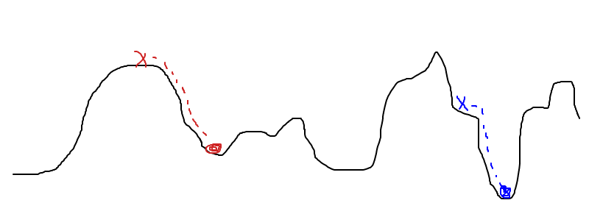


Hill-Descent
$$L\left(W\right)$$
$$W$$
“Climbing down from Everest in thick fog with amnesia"

Slide 4
Hill-Descent
$$L\left(W\right)$$
$$W$$
Question 1: What we need to take a step downwards ?

Slide 5
Hill-Descent
$$L\left(W\right)$$
$$W$$
Question 1: What we need to take a step downwards ?: Direction and step size

Slide 6
Hill-Descent
$$L\left(W\right)$$
$$W$$
Question 1: What we need to take a step downwards ?: Direction and step size

Slide 7

Hill-Descent
$$L\left(W\right)$$
$$W$$
Question 2: How do we find direction of decreasing $L\left(W\right)$?

Slide 8
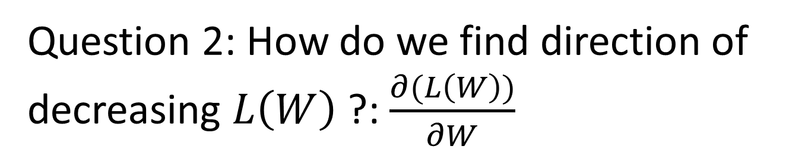
From Hill-Descent to Gradient-Descent
$$L\left(W\right)$$
$$W$$
Question 2: How do we find direction of decreasing $L\left(W\right)$?: $\frac{∂(L\left(W\right))}{∂W}$

Slide 9


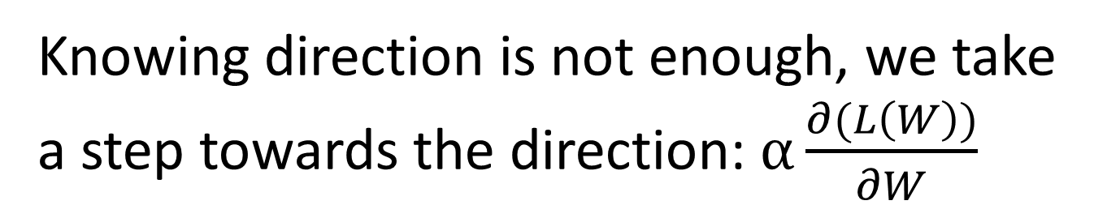
From Hill-Descent to Gradient-Descent
$$α$$
$$L\left(W\right)$$
$$\frac{∂(L\left(W\right))}{∂W}$$
$$W$$
Knowing direction is not enough, we take a step towards the direction: $α\frac{∂(L\left(W\right))}{∂W}$

Slide 10

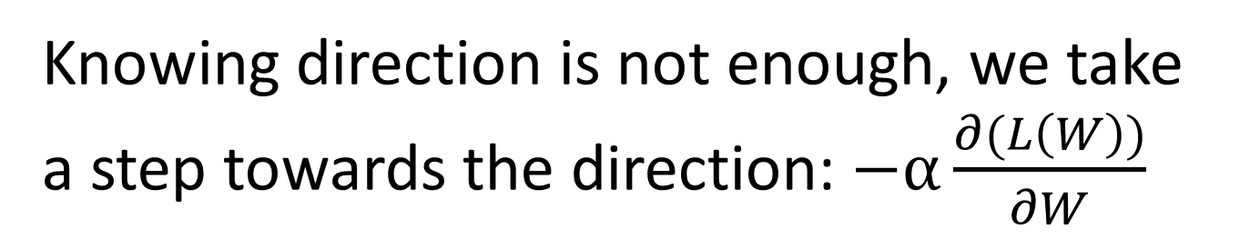
From Hill-Descent to Gradient-Descent
$$α$$
$$L\left(W\right)$$
- $\frac{∂(L\left(W\right))}{∂W}$
$$W$$
Knowing direction is not enough, we take a step towards the direction: $−α\frac{∂(L\left(W\right))}{∂W}$

Slide 11
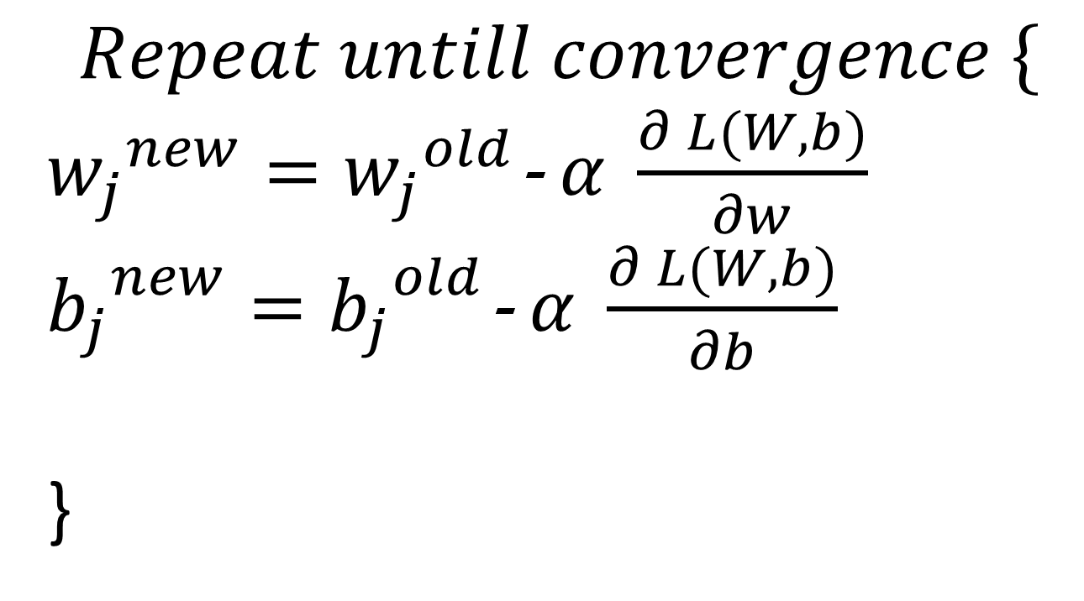
Gradient-Descent Algorithm
$$Repeat untill convergence \{$$
${w_{j}}^{new}={w_{j}}^{old}$- $α \frac{∂ L(W,b)}{∂w}$
${b_{j}}^{new}={b_{j}}^{old}$- $α \frac{∂ L(W,b)}{∂b}$
}

Slide 12

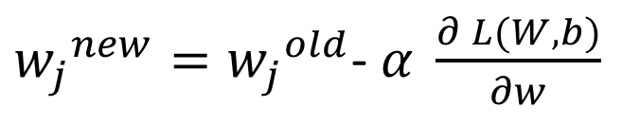

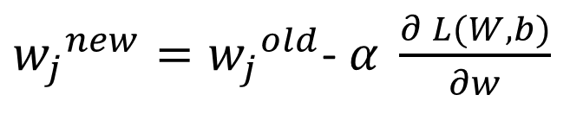


Gradient-Descent Algorithm: Why It Works ?
${w_{j}}^{new}={w_{j}}^{old}$- $α \frac{∂ L(W,b)}{∂w}$
$$L{(w}_{j})$$
$$w_{j}$$
${w_{j}}^{new}={w_{j}}^{old}$- $α \frac{∂ L(W,b)}{∂w}$
$$L(w_{j})$$
$$w_{j}$$

Slide 13
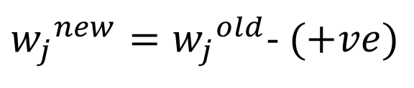


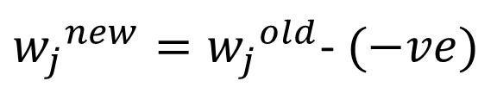
Gradient-Descent Algorithm: Why It Works ?
${w_{j}}^{new}={w_{j}}^{old}$- $α \frac{∂ L(W,b)}{∂w}$
$$L{(w}_{j})$$
${w_{j}}^{new}={w_{j}}^{old}$- $(+ve)$
$$w_{j}$$
$${w_{j}}^{new}<{w_{j}}^{old}$$
${w_{j}}^{new}={w_{j}}^{old}$- $α \frac{∂ L(W,b)}{∂w}$
$$L(w_{j})$$
${w_{j}}^{new}={w_{j}}^{old}$- $(−ve)$
$${w_{j}}^{new}>{w_{j}}^{old}$$
$$w_{j}$$

Slide 14

Gradient-Descent Algorithm: Why It Works ?
${w_{j}}^{new}={w_{j}}^{old}$- $α \frac{∂ L(W,b)}{∂w}$
$$L{(w}_{j})$$
$${w_{j}}^{new}={w_{j}}^{old}$$
Why ?
$$w_{j}$$

Slide 15


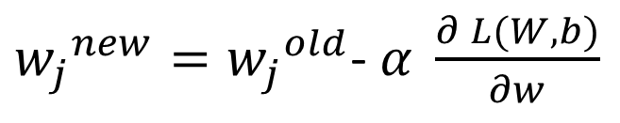


Gradient Descent Algorithm: Semantics of Learning Rate
${w_{j}}^{new}={w_{j}}^{old}$- $α \frac{∂ L(W,b)}{∂w}$
$$L{(w}_{j})$$
$$w_{j}$$
${w_{j}}^{new}={w_{j}}^{old}$- $α \frac{∂ L(W,b)}{∂w}$
$$L{(w}_{j})$$
$$w_{j}$$

Slide 16
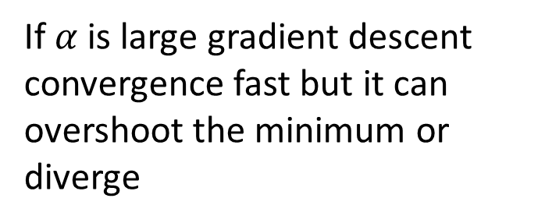
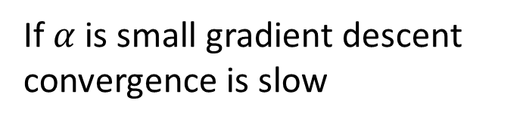
Gradient Descent Algorithm: Semantics of Learning Rate
${w_{j}}^{new}={w_{j}}^{old}$- $α \frac{∂ L(W,b)}{∂w}$
$$L{(w}_{j})$$
If $α$ is small gradient descent convergence is slow
$$w_{j}$$
${w_{j}}^{new}={w_{j}}^{old}$- $α \frac{∂ L(W,b)}{∂w}$
If $α$ is large gradient descent convergence fast but it can overshoot the minimum or diverge
$$L{(w}_{j})$$
$$w_{j}$$

Slide 17
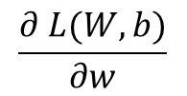

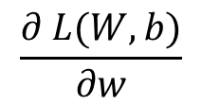

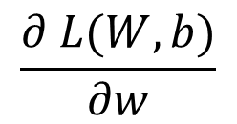
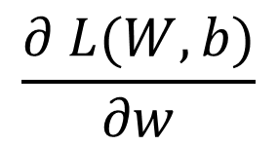
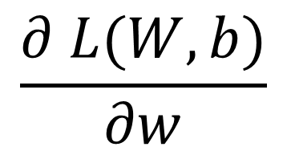

Convergence
$$\frac{∂ L(W,b)}{∂w}$$
$$\frac{∂ L(W,b)}{∂w}$$
$$L{(w}_{j})$$
$$\frac{∂ L(W,b)}{∂w}$$
$$w_{j}$$
$$\frac{∂ L(W,b)}{∂w}$$
$$\frac{∂ L(W,b)}{∂w}$$
$$\frac{∂ L(W,b)}{∂w}$$

Slide 18
Convergence
$$\frac{∂ L(W,b)}{∂w}$$
$$\frac{∂ L(W,b)}{∂w}$$
$$L{(w}_{j})$$
$$\frac{∂ L(W,b)}{∂w}$$
$$w_{j}$$
As it approaches to local minimum, gradient descent automatically takes smaller steps
$$\frac{∂ L(W,b)}{∂w}$$
$$\frac{∂ L(W,b)}{∂w}$$
$$\frac{∂ L(W,b)}{∂w}$$

Slide 19


Derivation of $\frac{∂ L(W,b)}{∂w}$
Loss function:
$L\left(W,b\right)= \sum_{i=1}^{m}{{(y −\hat{y})}^{2}}$
$\frac{∂ L(W,b)}{∂w}$ = $\frac{∂\sum_{i=1}^{m}{{(y −\hat{y})}^{2}}}{∂w}$ = …

Slide 20
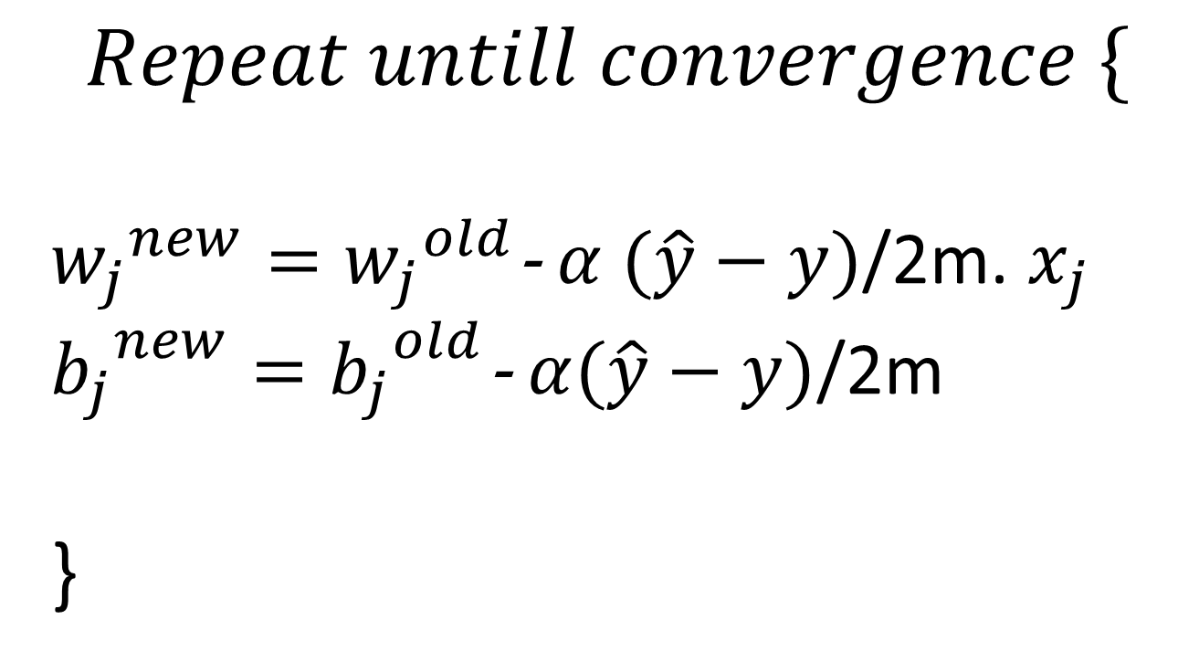
Gradient-Descent Algorithm
$$Repeat untill convergence \{$$
${w_{j}}^{new}={w_{j}}^{old}$- $α (\hat{y}−y)$/2m. $x_{j}$
${b_{j}}^{new}={b_{j}}^{old}$- $α(\hat{y}−y)\text{/}\text{2}\text{m}$
}

